Slide 1
Disclaimer
This information is intended to assist employers, workers, and others as they strive to improve workplace health and safety. While we attempt to thoroughly address specific topics, it is not possible to include discussion of everything necessary to ensure a healthy and safe working environment in a presentation of this nature. Thus, this information must be understood as a tool for addressing workplace hazards, rather than an exhaustive statement of an employer’s legal obligations, which are defined by statute, regulations, and standards. Likewise, to the extent that this information references practices or procedures that may enhance health or safety, but which are not required by a statute, regulation, or standard, it cannot, and does not, create additional legal obligations. Finally, over time, OSHA may modify rules and interpretations in light of new technology, information, or circumstances; to keep apprised of such developments, or to review information on a wide range of occupational safety and health topics, you can visit OSHA’s website at www.osha.gov.

Slide 2

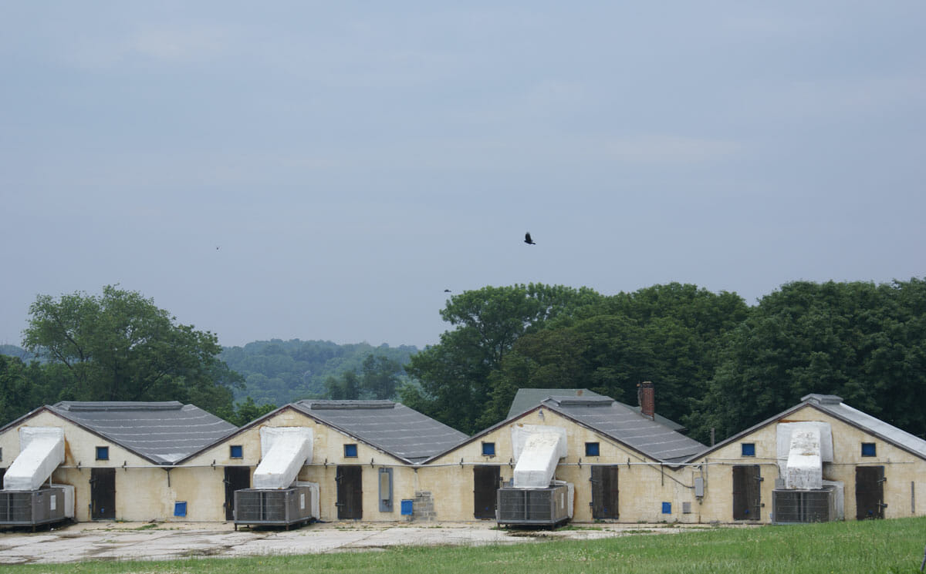
OSHA Standards We Have Talked About This Year
American Mushroom Institute
General Meeting
April 18, 2019
Hartefeld National, Avondale, PA

Slide 3
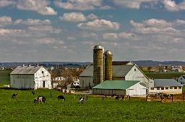
Agriculture 29 CFR 1928 Sub A
1928.1-This part contains occupational safety and health standards applicable to agricultural operations.
. . That none of the funds appropriated under this paragraph [OSHA funds] shall be obligated or expended to prescribe, issue, administer, or enforce any standard, rule, regulation, or order under the Occupational Safety and Health Act of 1970 which is applicable to any person who is engaged in a farming operation which does not maintain a temporary labor camp and employs ten or fewer employees . . . Public Law 102-170; November 22, 1991, 105

Slide 4
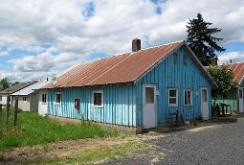
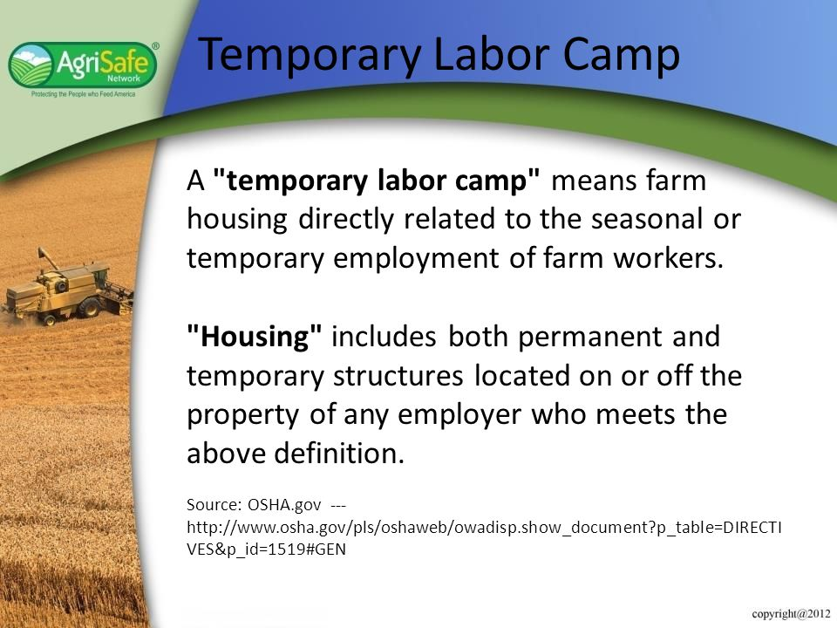
Agriculture 29 CFR 1928 Sub B
1928.21 (a) | GI Standards that Apply
Temporary labor camps - 1910.142 | Hazard communication - 1910.1200
Storage and handling of anhydrous ammonia - 1910.111(a) and (b) | Cadmium - 1910.1027
Logging Operations - 1910.266 | Retention of DOT markings, placards and labels - 1910.1201.
Slow-moving vehicles - 1910.145
1928.21(b) | GI Standards that DO NOT Apply
Subparts B through T | Subpart Z of part 1910

Slide 5
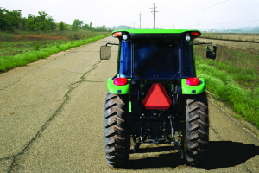
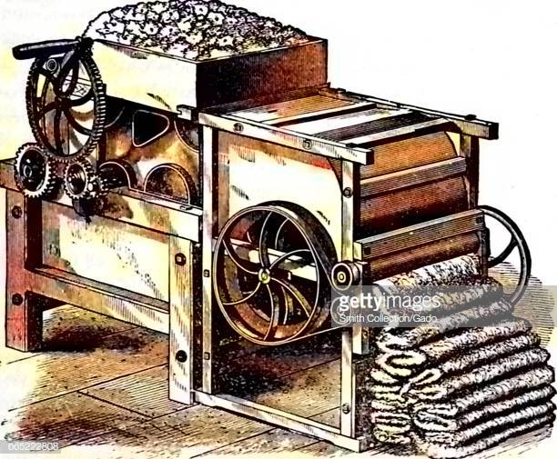
Agriculture 29 CFR 1928 Sub C & D
1928 Subpart C | Roll-Over Protective Structures
1928.51 ROPS for tractors | App A- Employee operating instruction
1928.52 Protective frames for wheel-type tractors | App B- Figures C-1 through C-16
1928.53 Protective enclosures for wheel-type tractors
1928 Subpart D | Safety for Agricultural Equipment
1928.57 Guarding of farm field equipment, farmstead equipment, | and cotton gins.

Slide 6
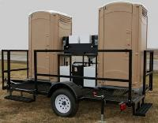
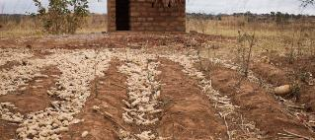
Agriculture 29 CFR 1928 Sub I & M
1928 Subpart I | General Environmental Controls
1928.110 Field Sanitation | 1928.110(c)(2) Toilet and handwashing facilities
1928.110(a) Scope | 1928.110(c)(3) Maintenance & Disposal
1928.110(b) Definitions | 1928.110(c)(4) Reasonable use
1928.110(c)(1) Potable water | 1928.110(d) Effective dates- May-July 1987
1928 Subpart M | Occupational Health
1928.1027 - Cadmium | Invokes 1910.1027 GI standard

Slide 7

General Duty Clause
Section 5(a)(1) of the OSH Act states: “Each employer shall furnish to each of his employees employment and a place of employment which are free from recognized hazards that are causing or are likely to cause death or serious physical harm to his employees."

Slide 8

Formalin
“formalin” is used to describe a saturated solution of formaldehyde dissolved in water, typically with another agent, most commonly methanol, added to stabilize the solution. Formalin is typically 37% formaldehyde by weight
The formaldehyde component provides the disinfectant effects of formalin.

Slide 9

Formalin
The OSHA Formaldehyde standard (29 CFR 1910.1048)
The (PEL) for formaldehyde is 0.75 parts formaldehyde per million parts of air (0.75 ppm) as an 8-hour (TWA).
(STEL) of 2 ppm which is the maximum exposure allowed during a 15-minute period.
Action level– 0.5 ppm as an 8 hour TWA

Slide 10

Provisions of the OSHA
Formalin Standard
Identify all workers who may be exposed
Reassign workers who suffer significant adverse effects from exposure
Implement feasible engineering and work practice controls
Label all mixtures or solutions composed of greater than 0.1 percent
Train all workers exposed to formaldehyde

Slide 11

Provisions of the OSHA
Formalin Standard
Select, provide and maintain appropriate personal protective equipment (PPE)
Provide showers and eyewash stations if splashing is likely.
Provide medical surveillance for all exposed at or above the action level or exceeding the STEL, for those who develop signs and symptoms of overexposure, and for all workers exposed to formaldehyde in emergencies.

Slide 12
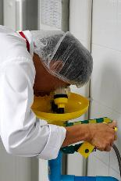
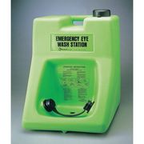
Showers and Eye Wash Stations
OSHA's primary Eyewash standard, 29 CFR 1910.151 states “where the eyes or body of any person may be exposed to injurious corrosive materials, suitable facilities for quick drenching or flushing of the eyes and body shall be provided within the work area for immediate emergency use.”

Slide 13



Showers and Eye Wash Stations
Though it does not have the force of a regulation under the OSH Act, the ANSI standard addressing emergency eyewash and shower equipment (ANSI [Z]358.1-2004)
ANSI's definition of "hazardous material" would include caustics, as well as additional substances and compounds that have the capability of producing adverse effects on the health and safety of humans.

Slide 14
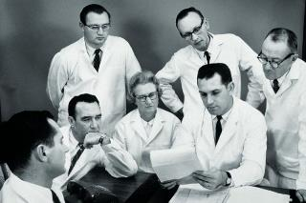
Showers and
Eye Wash Stations
ANSI's standard also provides detail with respect to the location, installation, nature, and maintenance of eyewash and shower equipment. You also may wish to consult additional recognized references such as W. Morton Grant's Toxicology of the Eye (Charles C Thomas Pub. Ltd., 4th edition, August 1993) when considering potential chemical exposures to the eye and the appropriateness of installing eyewash facilities to protect employees against hazards associated with particular chemicals and substances.

Slide 15
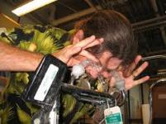
Showers and Eye Wash Stations
The employer must determine if employees can or will be exposed
If hazardous materials are present at a worksite in such a way that exposure could not occur (for example, in sealed containers that will not be opened, or caustic materials in building piping), then an eyewash or emergency shower would not be necessary.

Slide 16
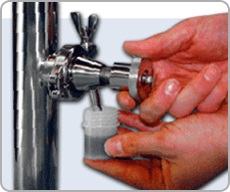
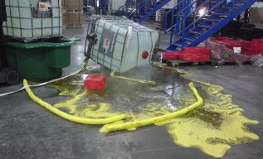
Showers and Eye Wash Stations
However, if the building piping containing caustic materials has, at certain locations, a spigot or tap from which the contents are to be sampled or withdrawn and employees are expected to perform such tasks, then, certainly, an eyewash and/or emergency shower would be needed where this task is to occur.

Slide 17
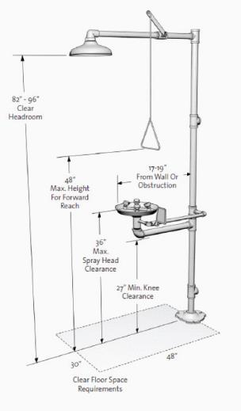
ANSI Emergency Showers
Safety Showers- 20 gallons per minute (gpm) at 30 psi, 20-inch diameter spray 60 inches above the surface, center of the spray head pattern should be at least 16 inches from any wall, door, or obstruction. It is recommended that the shower head be mounted between 82 and 96 inches off the floor, with the valve no higher than 69 inches.

Slide 18
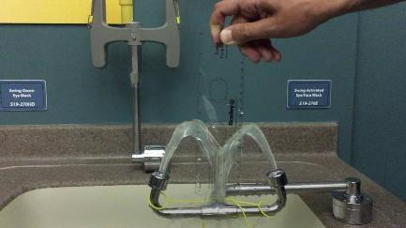
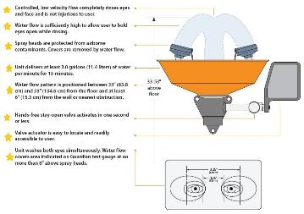
ANSI Emergency Eye Wash Station
Eye Wash- flow of 0.4 gpm also at 30 psi. The nozzles should be at least 6” from any obstruction and mounted between 33 and 45 inches above the floor. An eyewash gauge should be used to verify and test the flow.

Slide 19
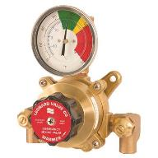
ANSI for both
Flow for at least 15 minutes. Safety shower at 20 gpm yields 300 gallons needed.
Personal wash devices are allowed, can provide immediate flushing while transiting to the fixture.
Can’t be allowed to freeze. Tepid water is now defined as having a temperature of between 60 and 100 degrees Fahrenheit.
Shower combined with an eyewash station, both devices must provide adequate flows and be fully operable at the same time.

Slide 20
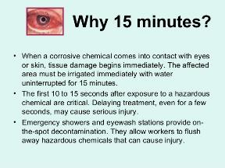
ANSI for both
Travel to the unit should be under 10 seconds for all hazardous areas that need this equipment. This equals about 55 feet.
Same level as the hazard and have a clear path for travel.
Recommends painting or marking the floor area underneath the shower to help keep it clear.
Z358.1 also recommends equipment be installed in a brightly lit area and marked with a highly visible safety sign.
Recommends weekly flushing for sediment

Slide 21




Slide 22

WPS Compliance
DECONTAMINATION SUPPLIES FOR WORKERS & HANDLERS To prevent, or mitigate pesticide exposures, the agricultural employer is required to provide supplies to each worker or handler (including early-entry workers) for routine washing to remove pesticide residues, emergency decontamination, and immediate eye flushing in certain situations. What supplies must be provided, when, where, and for how long are covered in Chapter 3 for workers and Chapter 4 for handlers.

Slide 23
WPS Compliance
Emergency eye flushing station: emergency eye flushing supplies must be provided at any site where handlers are mixing or loading a pesticide that requires protective eyewear or are mixing or loading any pesticide using a closed system operating under pressure. The supplies that must be available are: A system capable of delivering gently running water at a rate of at least 0.4 gallons per minute for at least 15 minutes, or At least 6 gallons of water in containers suitable for providing gently running water for eye flushing for 15 minutes. The container(s) must be able to dispense a gentle steady flow of water.

Slide 24
WPS Compliance
Additionally, when applying a pesticide that requires protective eyewear, 1 pint of water must be immediately available to each handler (applicator) in a portable container (on the applicator’s person or in the application equipment being used).

Slide 25

OSHA
www.osha.gov
800-321-OSHA (6742)

